Slide 1
What is Teacher Training?
The Gene Haas Foundation’s Teacher Training program is the premier CNC training program, for-teachers-by-teachers.
The program offers hands-on, project-based courses that equip new and existing CNC educators with the expertise and confidence to lead and prepare their students for the CNC machining industry of tomorrow.

Slide 2
Common Questions
Let’s answer some basic questions…
WHO should attend?
WHY should they attend?
WHAT will they gain from attending?

Slide 3
WHO should attend?
The program is intended for CNC instructors of all skill and experience levels who are…
looking to further their knowledge in CNC
want to build experience in g-code programming, setup and operation of CNC machines
interested in learning best practices in teaching CNC machining
could use some help defining strategies to help students connect the dots earlier

Slide 4
WHAT will be gained?
All attendees who complete the course…
Build expertise and confidence needed for the classroom by hands-on assisted training and trainer-led discussion
Exposed to unique teaching methods
Receive a certificate of completion
24-, 32-, 40 professional development hours (based on selected course)
Develop lasting connections with both trainers and trainees
Leave with all coursework

Slide 5
New and Improved
The Gene Haas Foundation Teacher Training Program was Redesigned during 2022/23
Updated learning objectives and strategies
Courses restructured to remove redundancy and create stepping stones from one class to the next.
New courses additions with more to come
Certificates of Completion are now provided at the completion of every course

Slide 6
Common Questions
Let’s answer a few more questions…
WHAT courses are available, and WHICH course is best for me?
WHERE can I attend a course, and HOW do I sign up?
WHO pays, and how much?

Slide 7
Courses
 | MILLING | TURNING | DESIGNED FOR THOSE WITH…
5-Day | Intro to CNC Milling | Intro to CNC Turning | Little or no (3-axis CNC mill / 2-axis CNC lathe) G-code programming, set up, and operation experience.
3-Day | CNC Milling | CNC Turning | Basic (3-axis CNC mill / 2-axis CNC lathe) G-code programming, set up, and operation experience, and little or no experience with multi-axis machining.
4-Day | Multi-Axis CNC Milling | * | Advanced 3-axis CNC mill G-code programming, set up, and operation experience, and interest in multi-axis (4- and 5-axis) set up and operation.
* No course in this study area at this time, though one is being discussed

Slide 8
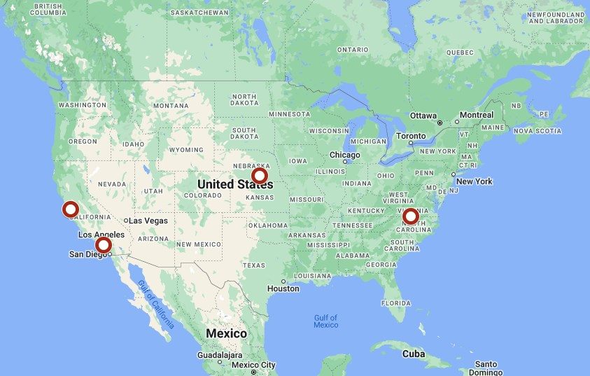
Locations
De Anza College Cupertino, California
Orange Coast College Costa Mesa, California
Central Community College Hastings, Nebraska
Danville Community College Danville, Virginia

Slide 9
Registration
A Few Simple Steps
GHF Website > Teacher Training
Review the map; know what makes sense geographically and financially for you
Review the course listings; note which you are prepared to attend benefit from
Review the calendar; are one of the desired courses upcoming, and does the location desired align?
Click on a class from the calendar; use the link to register*
https://www.ghaasfoundation.org
* Some locations do not have registration links, contact those by email or phone to register

Slide 10
Value, Scholarships & Cost
 | COURSE COST | SCHOLARSHIP | ATTENDING SCHOOL PAYS
5-Day Intro to CNC Milling OR Intro to CNC Turning | $2,550 | $2,200 | $350*
3-Day CNC Milling OR CNC Turning | $1,750 | $1,400 | $350*
4-Day Multi-Axis CNC Milling | $2,550 | $2,200 | $350*
* Costs above do not account for travel or accommodations

